Slide 1


Online Safety & Cybersecurity Program
A Comprehensive Strategy to Secure Our Digital Campus & Safeguard Learners

Slide 2
Executive Summary
Empowering our school community with robust digital defense, legal compliance (POPIA), and proactive cyber awareness for every learner and staff member.

Slide 3


Why Online Safety Matters
▪
Learner Safeguarding: Protects children against cyberbullying, online predators, and inappropriate digital content.
▪
POPIA Compliance: Ensures legal responsibility under the Protection of Personal Information Act for learner and financial records.
▪
▪
Digital Citizenship: Teaches learners responsible digital footprints and healthy internet practices from a young age.
Device Security: Guards school laptops, Wi-Fi networks, and e-learning portals against ransomware and phishing.

Slide 4


Core Program Pillars
Pillar 1: Infrastructure & Defense
Pillar 2: Education & Governance
Implementation of enterprise-grade Next-Gen Firewalls, DNS web filtering, segmented campus Wi-Fi, and endpoint antivirus across all school hardware.
Structured cyber-safety curriculum integrated into Life Orientation, staff cyber hygiene workshops, and active digital safety evenings for parents.

Slide 5









Key Stakeholder Roles
Management
Educators
Parents
Approves project budget, establishes school cybersecurity policies, and ensures POPIA regulatory compliance.
Integrates digital safety in classroom lessons, enforces secure device usage, and identifies online bullying indicators.
Enforces household digital rules, monitors home device usage, and collaborates with school safety guidance.

Slide 6

Implementation Budget
# | Item Description | Quantity | Unit Cost (R) | Total Cost (R) [Formula]
2 | Next-Gen Firewall & Web Filtering System | 1 | R 28 500.00 | R 28 500.00 =B2*C2
3 | Endpoint Antivirus Licenses (150 Devices) | 150 | R 350.00 | R 52 500.00 =B3*C3
4 | Teacher & Staff Cybersecurity Training | 4 | R 4 500.00 | R 18 000.00 =B4*C4
5 | Parent Digital Safety Awareness Seminars | 2 | R 3 000.00 | R 6 000.00 =B5*C5
6 | Student Cyber Curriculum & Workbooks | 500 | R 25.00 | R 12 500.00 =B6*C6
7 | POPIA Data Privacy & Compliance Audit | 1 | R 15 000.00 | R 15 000.00 =B7*C7
8 | GRAND TOTAL | R 132 500.00 =SUM(D2:D7)

Slide 7
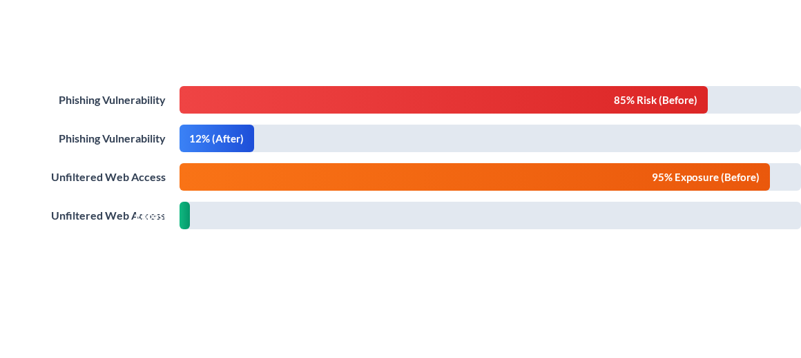
Threat Reduction Impact
Implementation reduces external threat exposure and email phishing susceptibility by over 85% within the first 90 days.

Slide 8




Implementation Roadmap
Phase 2: Technical Deployment
Firewall installation, web filters, antivirus rollout across campus devices.
Phase 4: Full Integration
Student curriculum rollout, incident response testing, and annual review.
Phase 1: Procurement
Phase 3: Community Workshops
Board approval, firewall procurement, and initial POPIA risk audit.
Teacher training sessions and parent cybersecurity awareness seminars.

Slide 9

Infrastructure Security
Robust Network Perimeter
Deploying centralized threat management guarantees that every device connected to the school network operates behind enterprise-grade security filters.
Learner Wi-Fi networks are isolated from administrative databases, safeguarding confidential academic records and financial systems from unauthorized access.

Slide 10
Key Target Metrics
100%
Measurable Safety Outcomes
By establishing rigorous endpoint controls, mandatory staff training, and web filtering, our school achieves zero data breach vulnerabilities, complete regulatory compliance, and 100% active coverage across all staff and student user profiles.
POPIA Data Protection Compliance

Slide 11
Safeguarding Commitment
Cybersecurity is not merely an IT upgrade; it is a vital child safeguarding obligation in the modern digital age.
"
"
— Proposal Core Principle

Slide 12


Image Sources
https://www.ftc.net/wp-content/uploads/2024/04/Teacher-helping-student-with-laptop-1024x538.jpg
Source: www.ftc.net
https://images.stockcake.com/public/e/7/f/e7f71d85-1160-44e0-8899-574e97eaa905_large/cybersecurity-network-protection-stockcake.jpg
Source: stockcake.com

